Slide 1
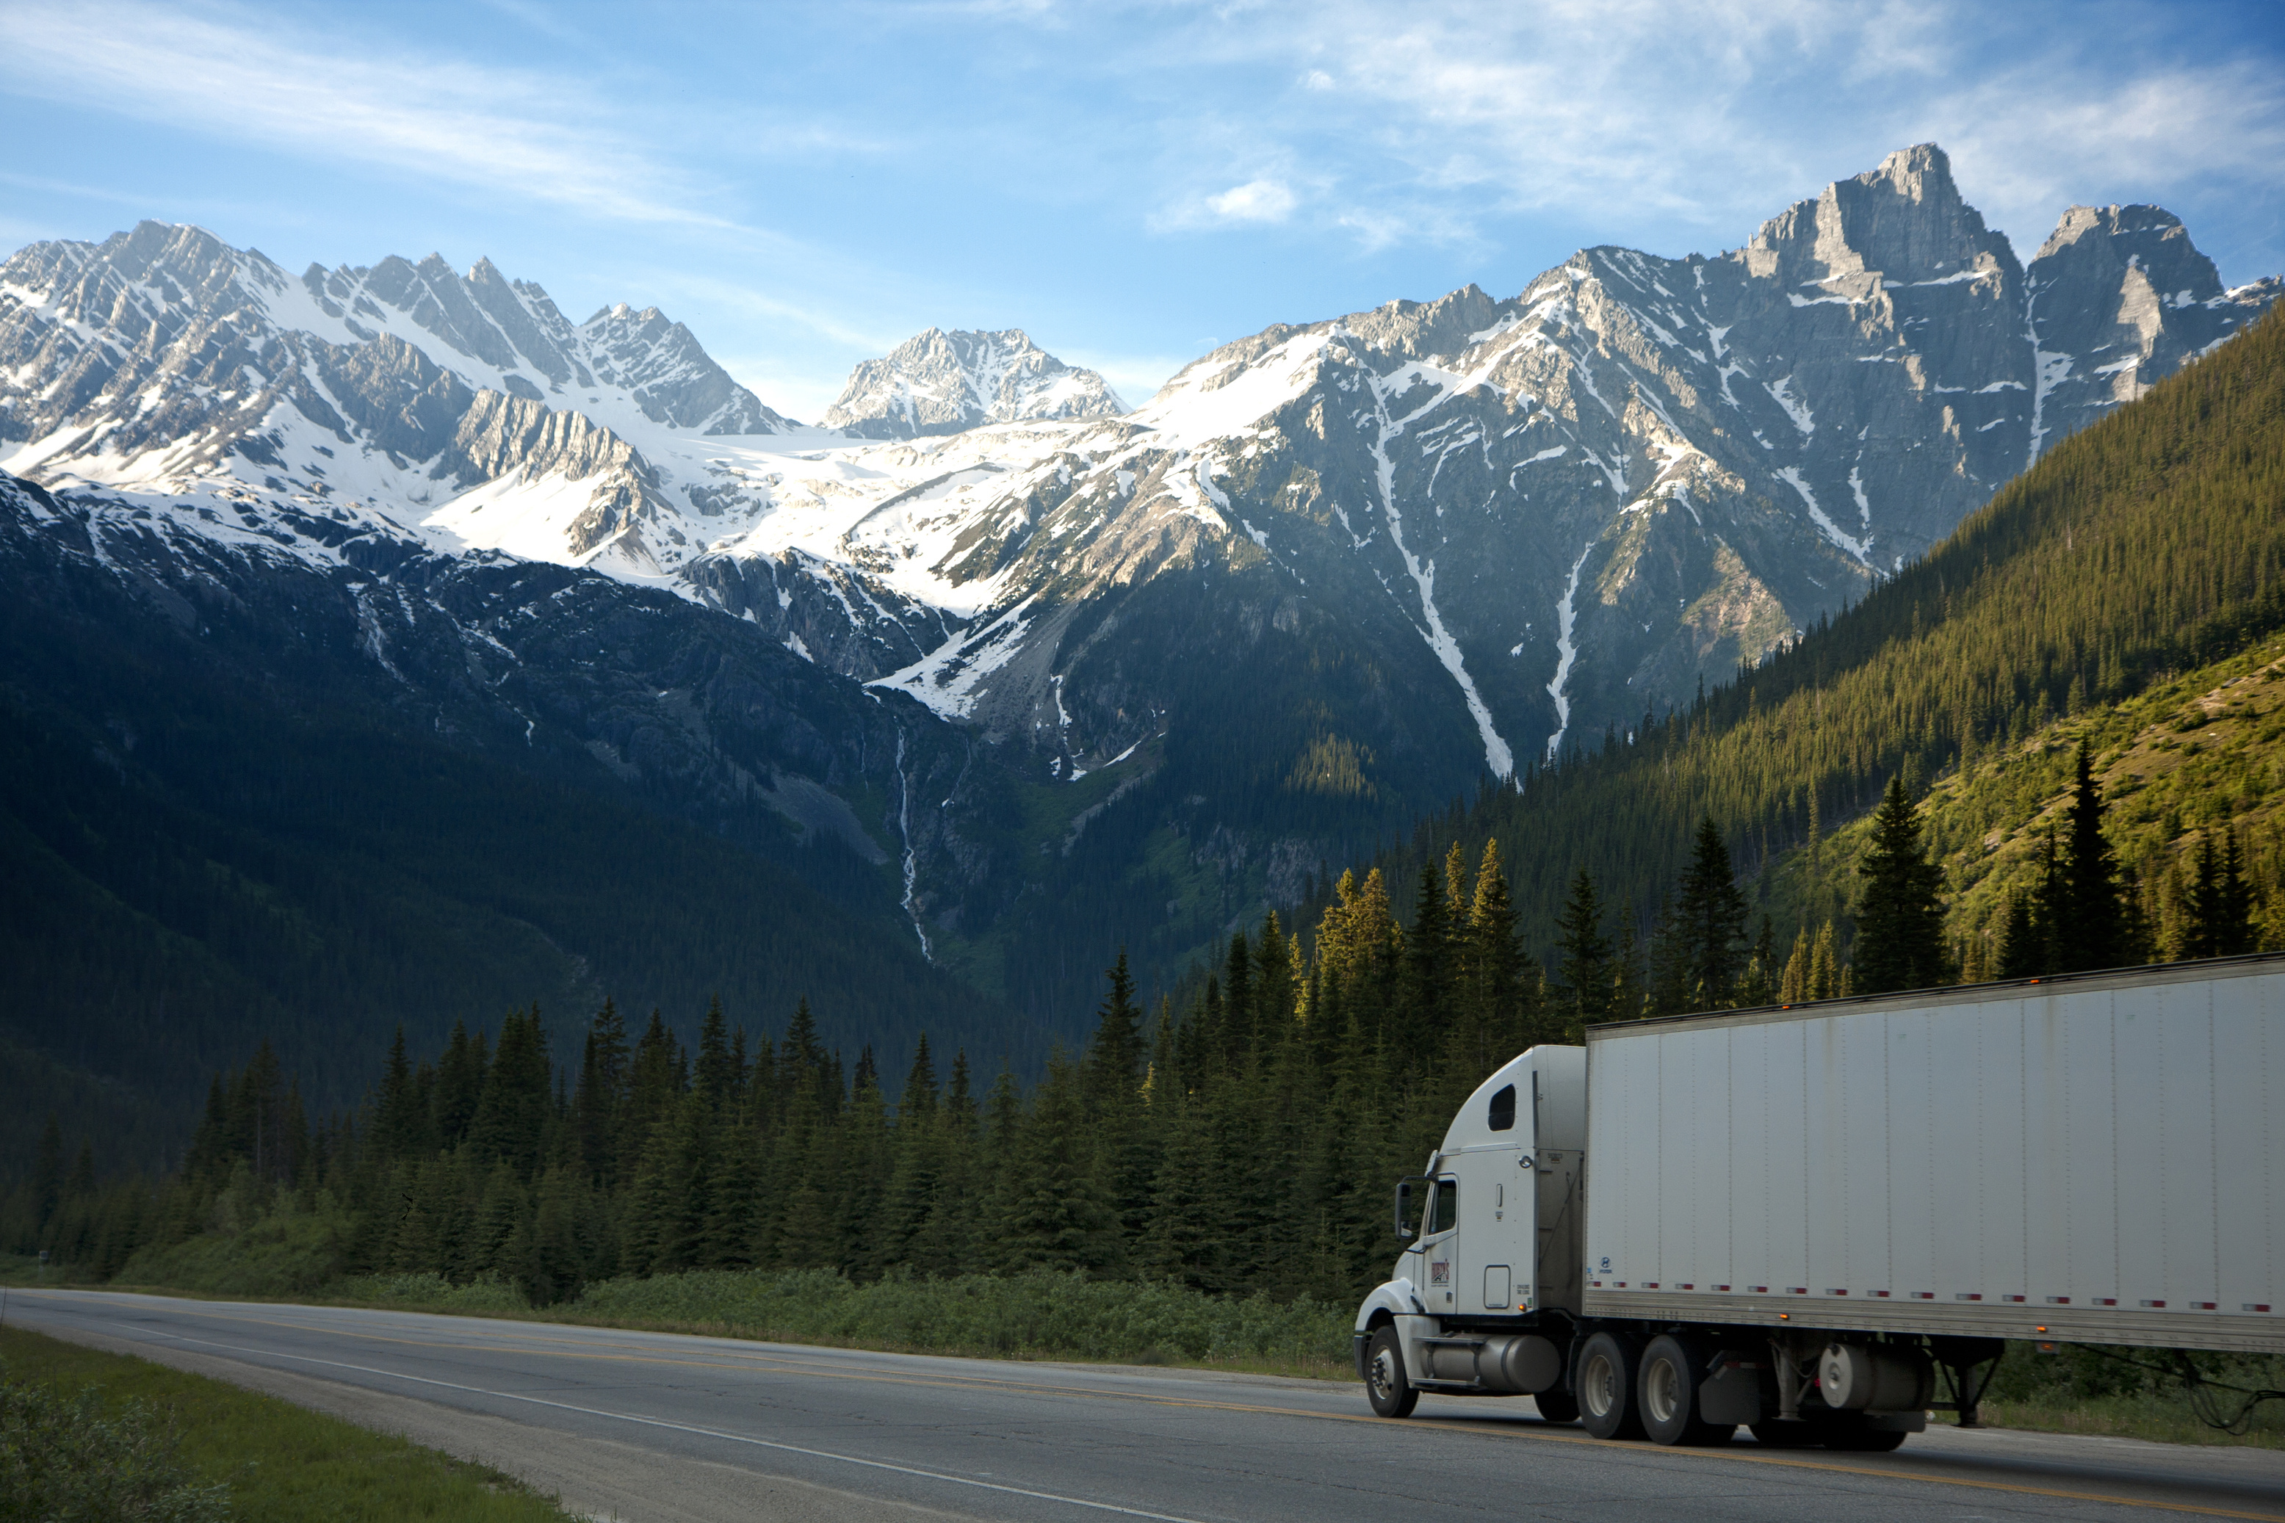
ANT’s Risk Analysis
Exploring risk factors of truck drivers and truck models
Team members:
Manmohan Dash
Pavithra Narasimhan
Nikhita Mandava
Mahesh Potdar
Dedeepya Vemuri
Jaya Mangamuri

Slide 2
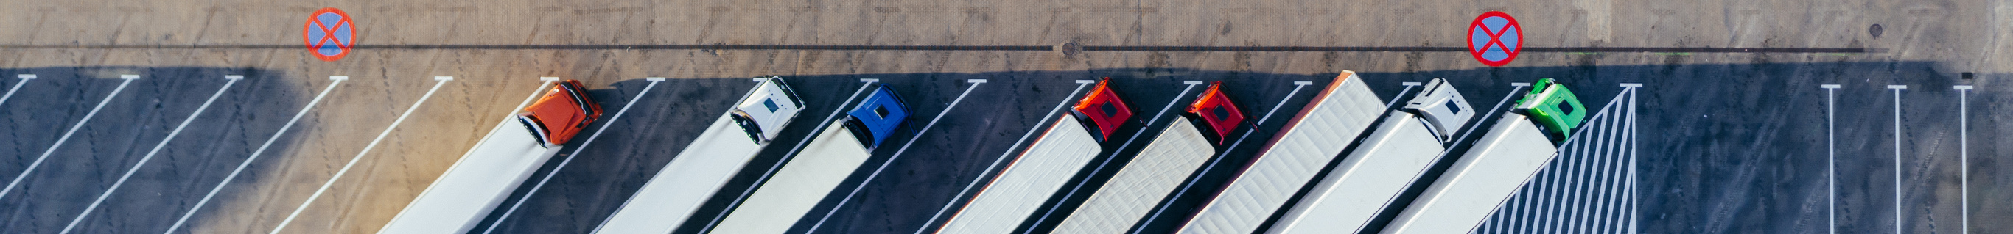
OBJECTIVE
As decision-makers at Az National Trucking (ANT), our objective is to pinpoint high-risk drivers through comprehensive analysis of driving events, total mileage, average speeds, truck models, and other relevant metrics from the dataset provided. Additionally, our focus is on mitigating insurance risks linked to factors like speeding, unsafe following distances, lane departure incidents, and other hazardous driving practices.

Slide 3







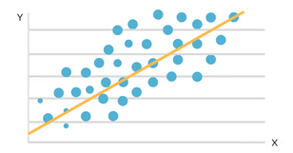
PROJECT FLOW CHART
Initiate data download
from the internet.
Transfer dataset to local VM storage
ACQUIRE DATA
MOVE FILES
DATA SETUP IN HDFS
Relocate dataset to HDFS's primary directory
Create tables within HDFS for the files
Employ pig scripts to augment the risk factor table
Load dataset into the
new tables
Configure Tableau to access
HDFS
TABLEAU AND HDFS SYNCHRONIZATION
IMPALA INTEGRATION
DATA ENRICHMENT IN PIG
Using ODBC drivers import tables in Tableau to visualize the dashboards
REGRESSION ANALYSIS
TABLEAU AND R INTEGRATION
Apply regression analysis
to forecast the risk
assessment factor

Slide 4

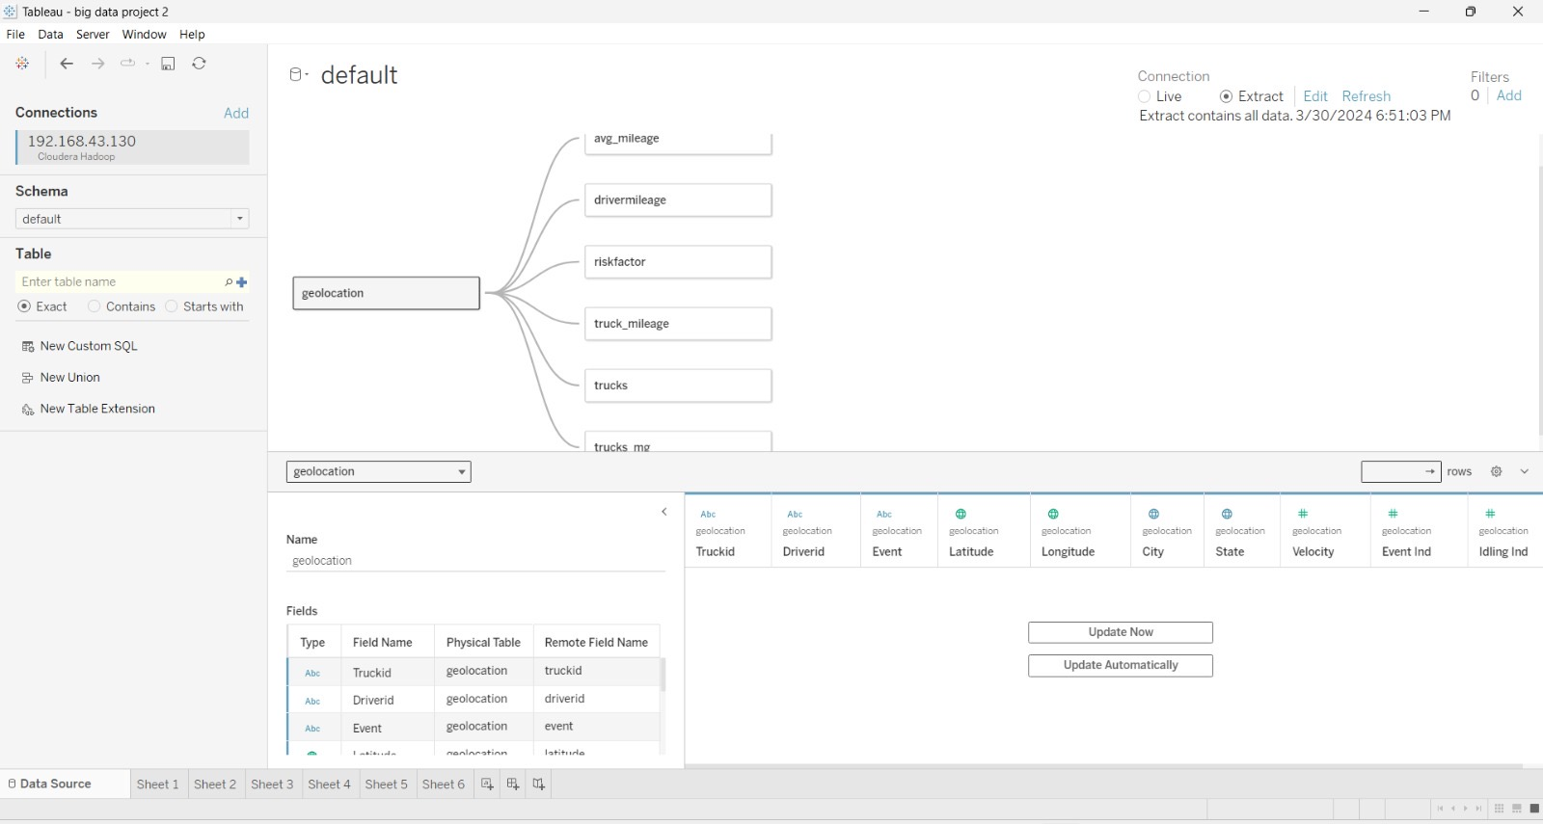
DATASET DESCRIPTION

Slide 5

Top 10 Riskiest Cities
Top Riskiest Drivers in these cities
OUR APPROACH FOR THE ANALYSIS
Top Riskiest Truck Models driven by these drivers
Riskiest truck model and riskiest truck driver along with their attributes

Slide 6
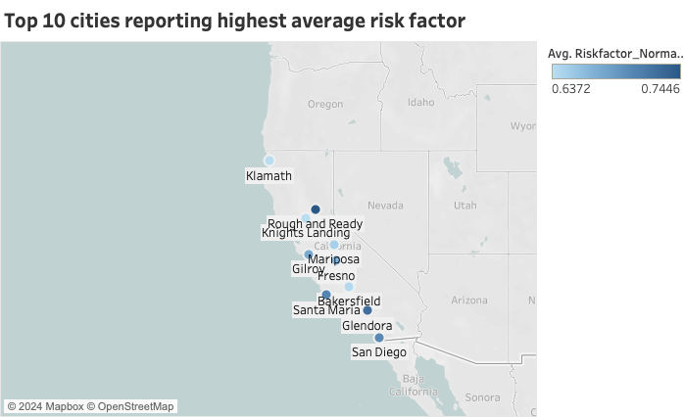
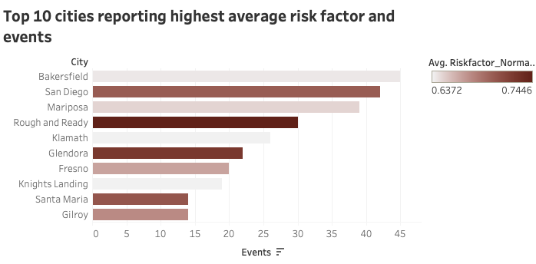
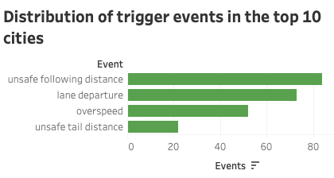
What are the cities with the highest reported average risk factor?
Insights & recommendation
Rough and Ready comes out to be the highest risk factored city
These 10 cities have unsafe following distance as the highest occurred event
These information can aid the company in devising strategies to monitor movement across these areas effectively
Strategic decisions regarding expansion, market penetration, or resource allocation in these cities should be based on these information

Slide 7
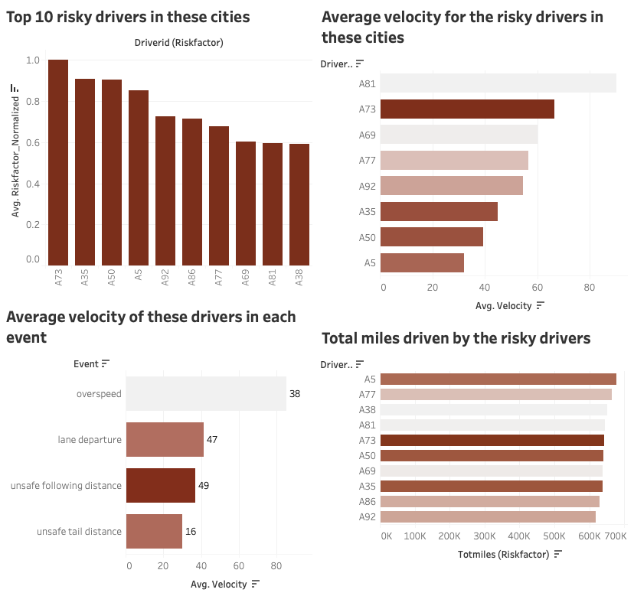
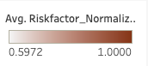
Who are the riskiest drivers operating in these cities?
Insights & recommendation
No significant difference in terms of experience (similar trends in total miles)
Unsafe following distance is the most risk factored event with the average velocity of 37.08 units
Getting these information about average velocity and events, can help the company design training programs for these risky drivers

Slide 8
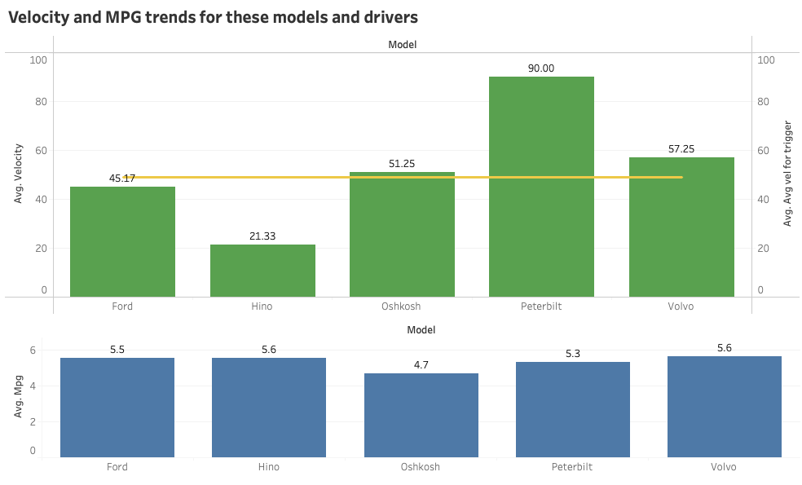
What are the velocity and MPG trends across the truck models driven by the riskiest drivers in these cities?
Insights & recommendation
Safety Protocols: Utilizing insights on average velocity thresholds, safety guidelines for drivers can be established, minimizing accident risk
Efficiency Optimization: Average mpg can be analysed to prioritize maintenance and vehicle replacements
Fleet Management and Route Optimization: Prioritize faster models (but within velocity threshold) for urgent deliveries, while favouring higher mileage vehicles for routes where time constraints are less critical

Slide 9
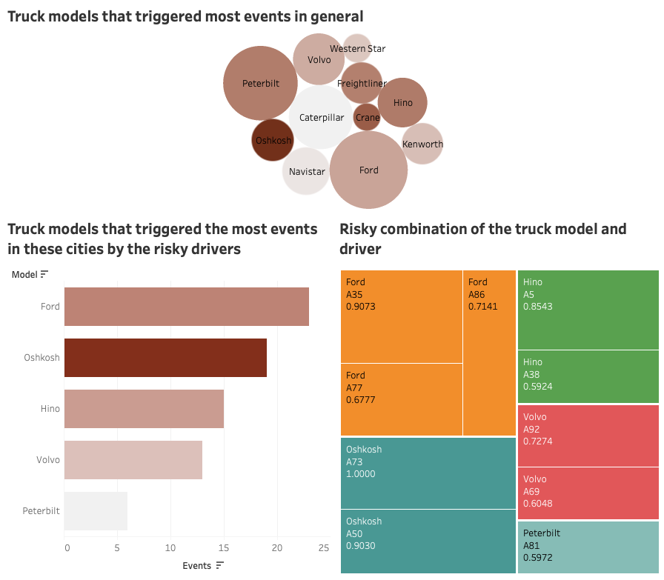
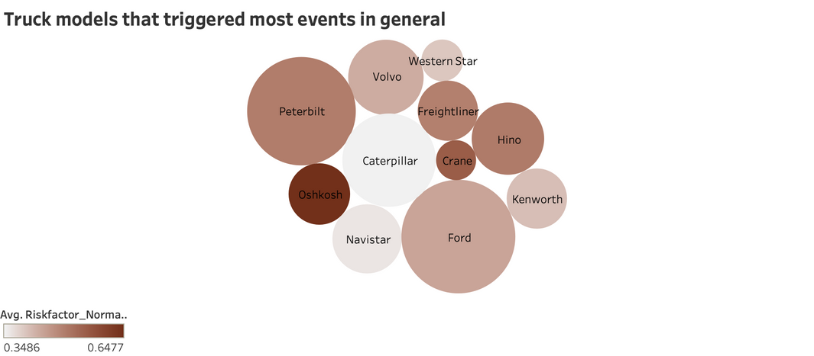
What are the models driven by the riskiest drivers in these cities?
Insights & recommendation
In the overall pattern across all cities, Ford triggered the highest number of events. The top 10 cities see similar trend in line with the overall trend
Among the models, the risk factor was reported highest for Oshkosh, followed by Ford, in the top 10 cities with the highest risk factors
Knowing these models can help in :
1. Improve Maintenance Procedures
2. Optimize Fleet Management
3. Enhance Safety Protocols

Slide 10
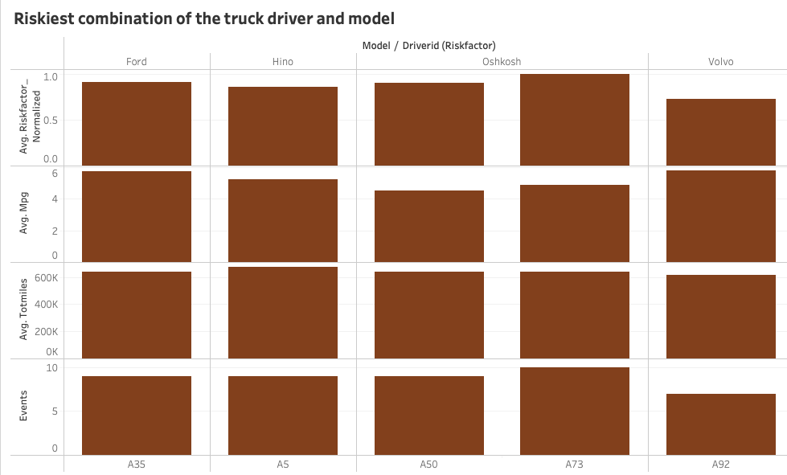
Which model-driver combination should be avoided?
Insights & recommendation
•Both the drivers that drive Oshkosh in the top 5 riskiest driver list are classified as High Risk Drivers
•All of the 5 drivers have similar range of total miles driven, indicating similar experience as drivers
•Oshkosh model seems to be the one with poorer mileage performance and at the same time higher risk factored
•Examination of the attributes of the riskiest drivers in the top 5 risk-factored cities provides insights into their driving behaviours and characteristics
•Utilizing city-wise benchmarks, customized strategies and interventions can be developed

Slide 11

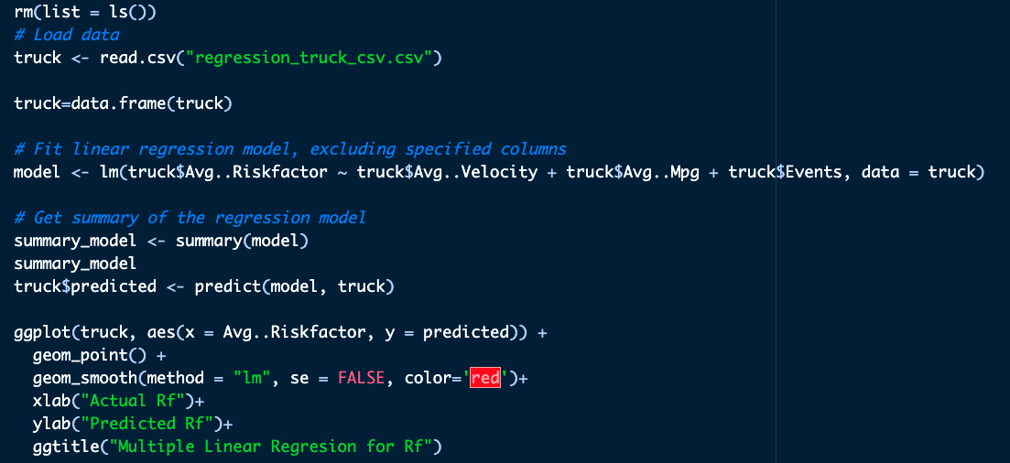
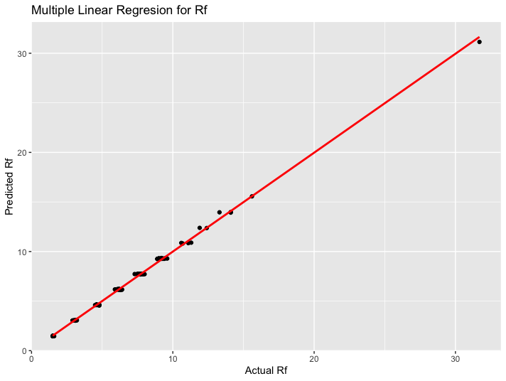
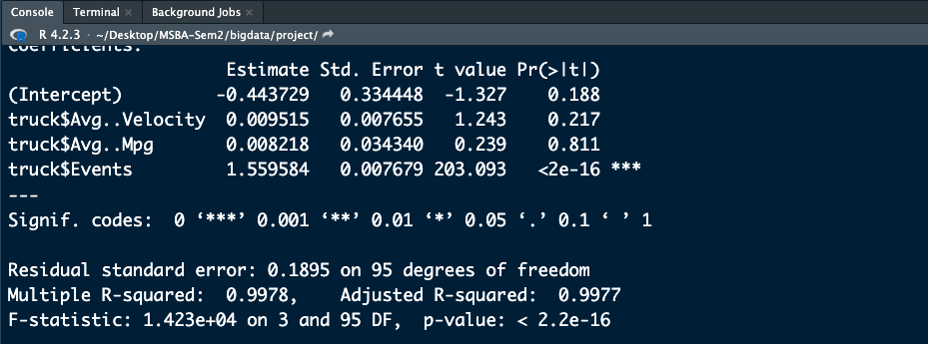
Regression modelling with R
• Integrated Tableau visualization with R studios
• Plotted the actual data against the predicted Risk factor
• Obtained an adjusted R square of 0.997

Slide 12
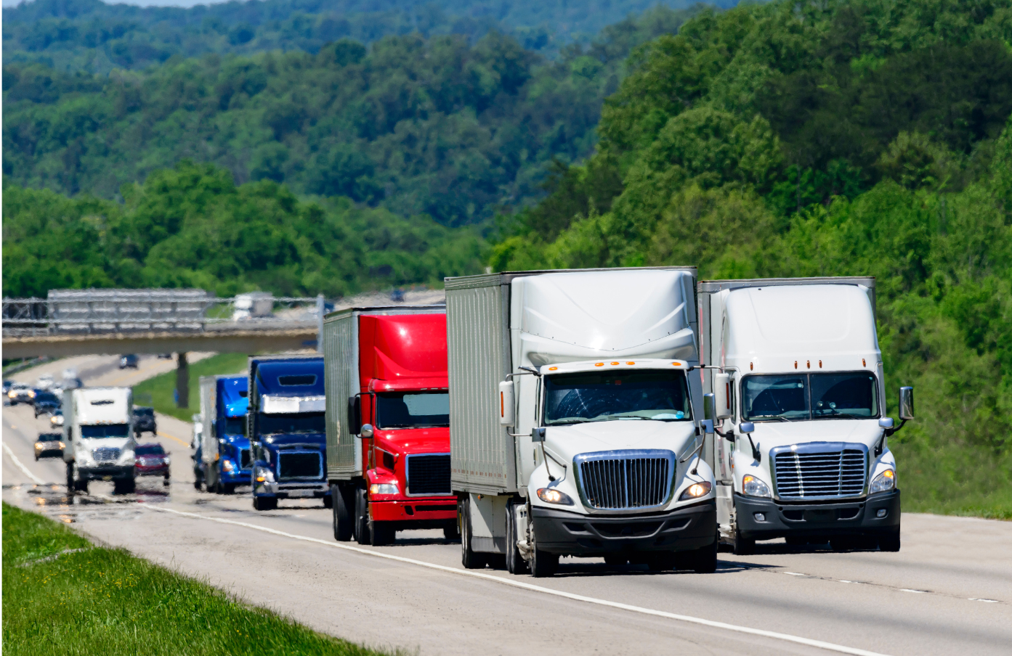
Thank you.

